Slide 1

Publishing Websites on Search Engines
Presented by: Zayna Amierh, Enas Ibraiwesh, Lina Badawi, and Heba Hanandeh

Slide 2

What is a Search Engine?
A Search Engine is a program which searched and identifies specific items in a database which corresponds to any keyword or character specified by user on the search bar.
Things to Consider about Search Engines (especially when publishing websites):
How the Search Engines work
Searching is personalized
Searching is getting smarter
Typically there are three main search engines which are commonly used. They are:
Google
Bing
Yahoo

Slide 3

How to Publish a Website on Search Engines Individually

Slide 4

Google
Steps to publishing a website on google manually:
Register in Google Search Console and select the website and then preview the URL.
Write the URL of the web page you want Google to crawl and then enter.
The URL inspection report displays the crawl data updates for this page and then click on "Request Indexing".
After Google has tested the URL to make sure it exists, you will see the message "Indexing is required.“
Finally press Got it to close the dialog box
Note: It is important to keep in mind if you want to publish an entire website, you must create a sitemap and submit it through the search console

Slide 5
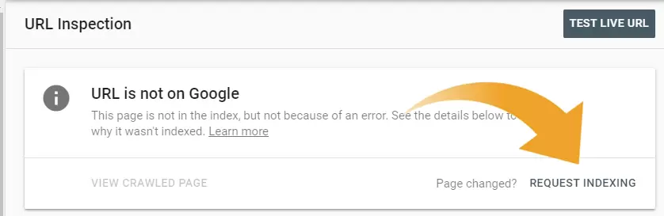
This is the warning that will pop out and sends you a request for indexing

Slide 6

Bing
Steps to publish a website on Bing:
Sign in to Bing Webmaster Tools. but if you have Google Search Console, Bing pulls verification information there.)
Determine the appropriate location.
From the menu, choose Configure My Location> Submit URLs.
Write down the URLs that we want to send for indexing from the website, one per line and then submit

Slide 7
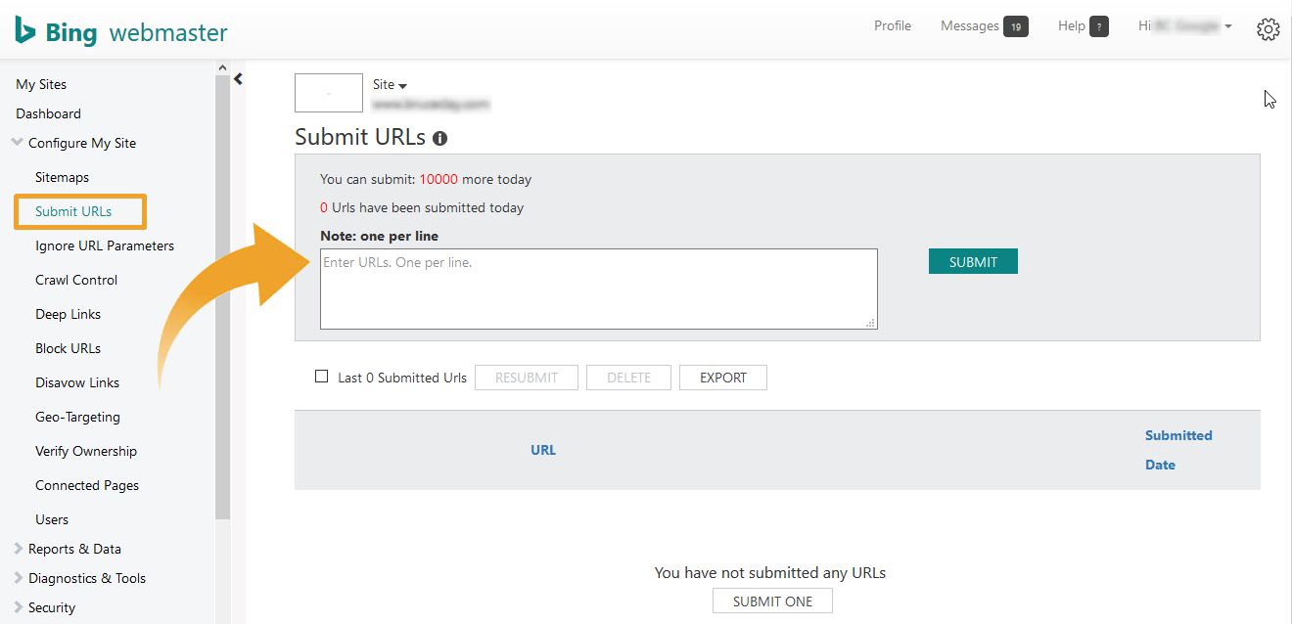

Slide 8
Yahoo
The publishing process to submit a website to yahoo is similar to the Bing process due to the fact that Bing has recently bought Yahoo company. Steps include:
Submit a site map in Bing Webmaster Tools.
Webmaster Tools> "Add your site"> Fill out the form> click "Submit"
Your location will be automatically sent to Yahoo.

Slide 9
Publishing Website using a Tool
A simpler way to publish the website rather than doing all manual is by using a tool
One tool used to publish website on all search engines automatically is a website called “Entireweb”
Steps:
we write the URL in a dedicated box.
And then we enter our Gmail in a dedicated place, then we press proceed.
Then we turn to page to choose a plan that fits you
There are 3 plans that can be selected and each plan has special benefits
Plans include:
1) free submission 2) Entireweb SEO 3) Entireweb directory
The first plan is free and has ads
The second plan pays $ 1 for the first month
The third plan we pay $ 8 per month
5. After selecting the plan ,check your gmail to confirm submission

Slide 10

A page appears with all the search engines that were published, and then clicked “click here to complete your submission to bing” to submit your site to bing.
And so we're done publishing

Slide 11


Tips to Improve Search Engine Optimization Ranking
What is Search Engine Optimization?
Optimize the mobile version of your site.
Focus on the user experience of your website
Use long tail keywords in your SEO strategy..
Add more than texts
Improve your page loading speed
Produce high quality content
Break up your content with header tags
Use outbound links
Strengthen your social media presence.
Secure your site with HTTPS.

Slide 12
Thank you!

